Slide 1
As keyword

Slide 2
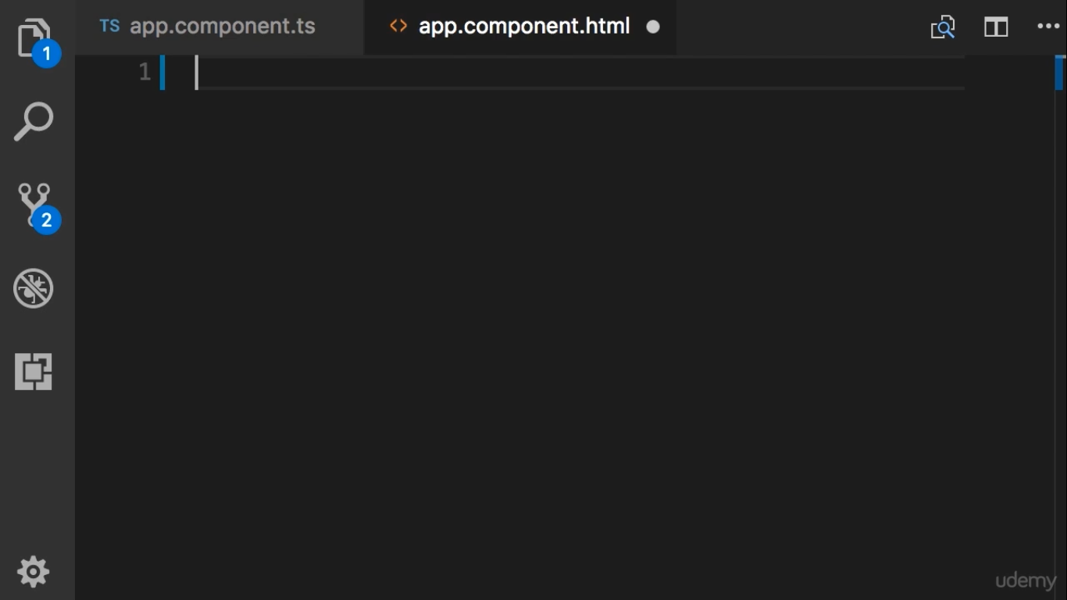
Imagine we are building a page to display profile of an author

Slide 3
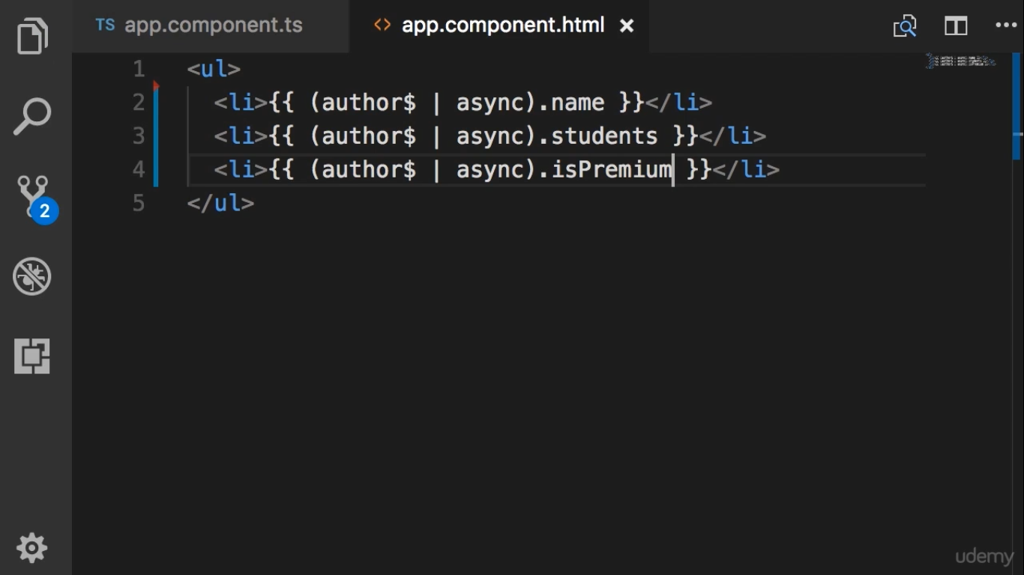

Slide 4
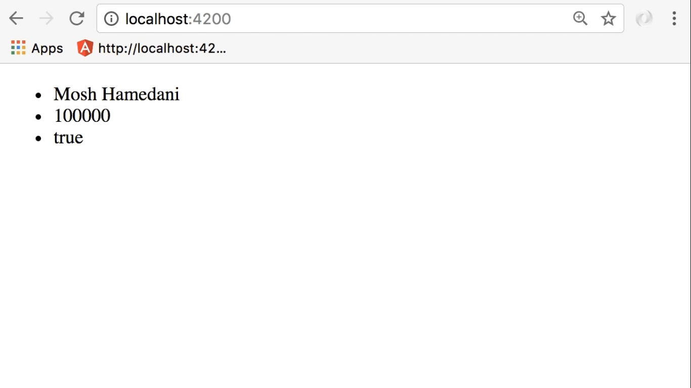

Slide 5
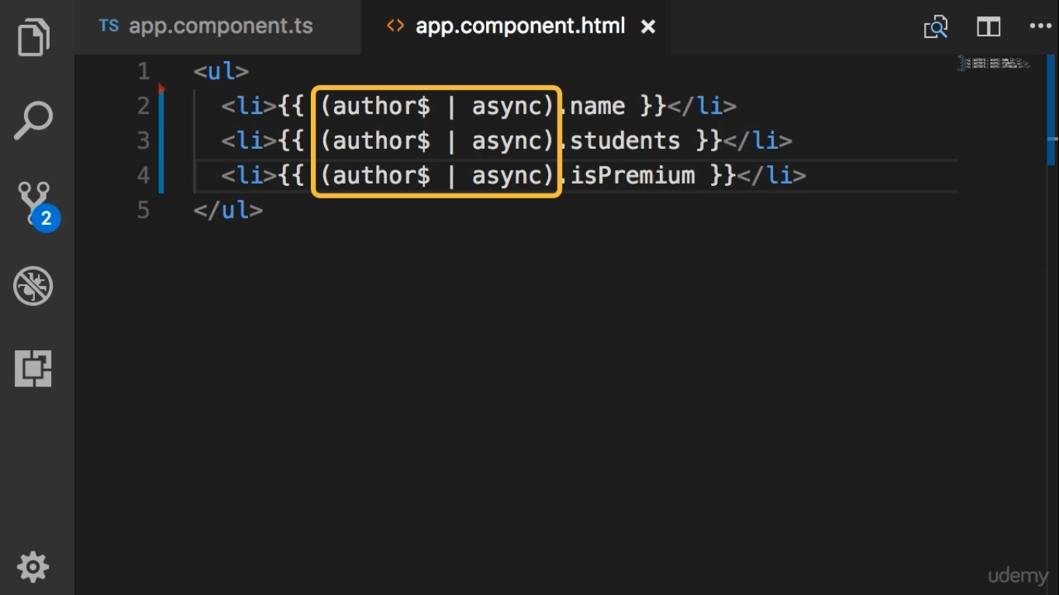
This code is repeatation

Slide 6
